Slide 1
Obstructive Jaundice & Anesthetic Implications
Dr. Lakshmi Kumar, Amrita Institute of Medical Sciences, Kochi

Slide 2
Model for discussion
What is Obstructive jaundice and its common etiology?
Pathophysiology of Obstructive jaundice.
Implications for Anesthesia
Optimal management
Summary and conclusions

Slide 3
Case scenario
A 60 year old male patient presents with history of
Generalized itching since 1 month
Yellowish discoloration of eyes since 15 days
Dark colored urine and pale colored stools since 15 days
Loss of appetite and weight since 6 months

Slide 4
Obstructive jaundice
Jaundice is a yellowish discoloration of the skin and sclera due to an increase in the levels of bilirubin( > 2 mg/dL)
Obstructive Jaundice is associated with failure of bile to reach the duodenum
Pathology anywhere from the hepatocyte to the ampulla of Vater

Slide 5
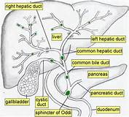
Biliary anatomy

Slide 6
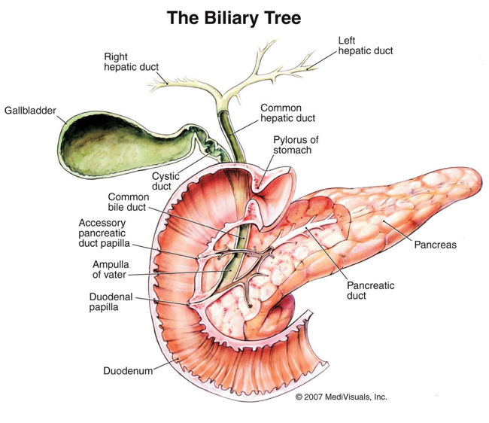
Sites for Obstruction

Slide 7
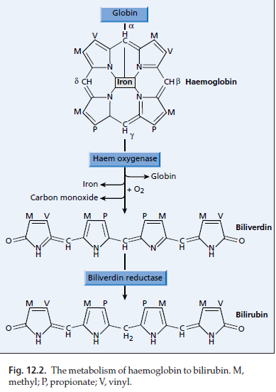
Formation of Bilirubin

Slide 8
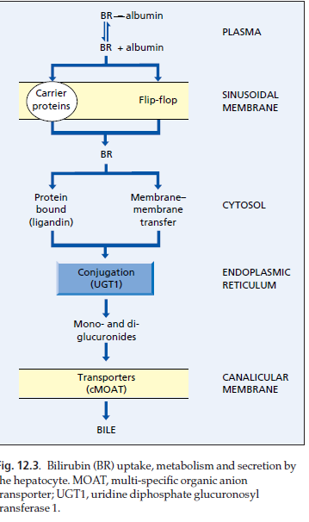
Bile formation & Excretion
Bilirubin tightly bound to albumin in a 1:1 ratio
Dissociation from albumin and passage through the plasma membrane
Cytosolic binding with ligandin and Z protein
Conjugation at the ER (UDP Glucuronyl transferase)
Excretion in the canaliculi against a concentration gradient

Slide 9
Primary Bile Acids and Salts
Cholic acid
BILE ACIDS
Chenodeoxycholic acid
Glycocholic
Taurocholic
Glycochenodeoxycholic
Taurochenodeoxycholic
BILE SALTS
Bile salts (Conjugated bile acids):
amide-linked with glycine or taurine
The ratio of glycine to taurine forms in the bile is
3:1

Slide 10
Functions of Bile Salts
Important for cholesterol excretion:
1. As metabolic products of cholesterol
2. Solubilizer of cholesterol in bile
Emulsifying factors for dietary lipids,
a prerequisite step for efficient lipid digestion
Cofactor for pancreatic lipase and PLA2
Facilitate intestinal lipid absorption by
formation of mixed micelle

Slide 11
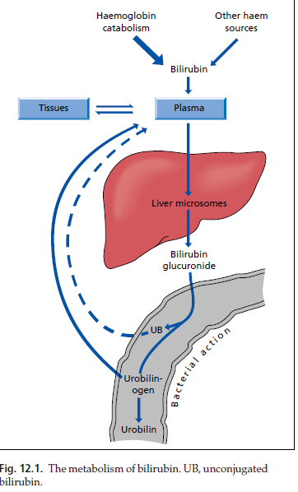
Enterohepatic Circulation

Slide 12
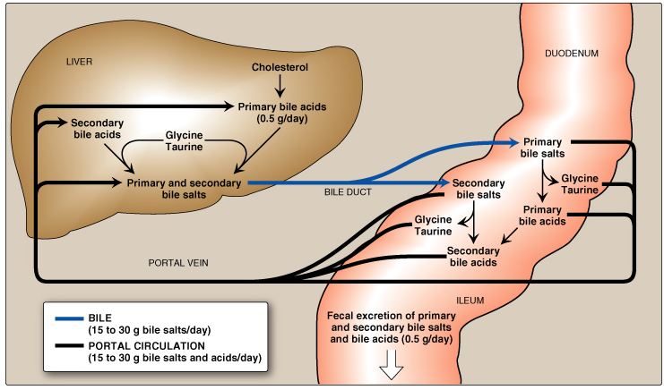
Enterohepatic Circulation

Slide 13
Functions of Bile
Absorption ,transport and secretion of lipids
Activate lipases, promote micelle formation and allow uptake of fat soluble vitamins and cholesterol
Allow excretion of lipophilic xenobiotics, cholesterol and steroid hormones

Slide 14
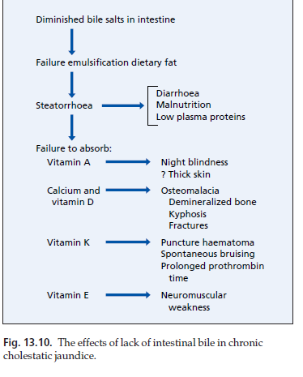
Obstructive Jaundice
Retention of Cholesterol and phospholipids cause hyperlipidemia
Triglycerides are unaffected
Lipids circulate as a unique low density lipoprotein called lipoprotein X

Slide 15
Obstructive Jaundice
Cholestasis associated with
Hepatocyte dysfunction,
impairment of the anti-oxidant defense responses
mitochondrial dysfunction
Impairment of mitochondrial oxidative function and accumulation of bile acids predisposes to oxygen derived free radicles

Slide 16
Common causes for Obstructive jaundice
Choledocholithiasis
Peri-ampullary carcinoma
Biliary Strictures
Cholangiocarcinoma
Choledochal cyst, biliary atresia

Slide 17
Implications for the anesthetist

Slide 18
Factors that increase morbidity in Obstructive Jaundice
Malignancy
Malnutrition (Hypoalbuminemia)
Azotemia
Increase in age
Intensity of jaundice (Bilirubin levels > 17 mg/dL)

Slide 19
Anesthetic Concerns: Coagulopathy
Coagulopathy:
Vitamin K dependant clotting factors
Hepatocellular failure: Decreased synthesis
Administration of Vitamin K 10 mg IV or 3 doses subcutaneously

Slide 20
Anaesthetic concerns: Retrograde bacterial translocation
Biliary sepsis is very common.
Normally regress of bacteria from the intestine in the biliary system.
Kept in check by bile salts, RES
In patients with partial biliary obstruction, those with ERCP or with biliary drainage procedures, or enteric drainage
Gram negative bacteria, Psuedomonas, E Coli, Klebsiella, Streptococcus

Slide 21
Anesthetic Concerns: Renal Dysfunction
Renal Dysfunction
More prone to develop renal dysfunction with hypovolemia.
Hepatocellular failure and splanchnic vasodilatation, renal vasoconstriction with activation of RAA
Unconjugated hyperbilirubinemia / ATN/ enterotoxins
Contrast Nephropathy during evaluation
Osmotic load due to bile salts predispose to ATN and deposition of bile salts in renal tubules.
Adequate hydration
Mannitol?

Slide 22
Anaesthetic : Cardiovascular System
Bile salts have a negative inotropic effect.
Bile salts reduce the peak action potential and duration of action potential at the myocyte.
Down regulate the effects of inotropes by disrupting their binding to the receptor protein.
In obstructive jaundice, decrease in SVR and a tendency to hypotension following hemorrhage can predispose to complications in a hypovolemic state.

Slide 23
Management of Anaesthesia

Slide 24
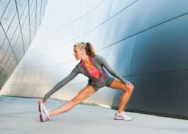

Prehabilitation

Slide 25
What can be done?
Correction of coagulopathy
Adequate hydration
Incentive spirometry
Correction of anemia
Improvement of muscle mass
Fatty liver donors can improve graft quality within 3-4 weeks of this measure

Slide 26
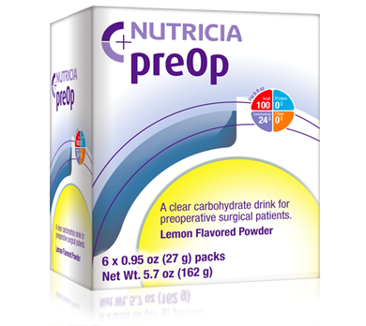
12.5 % complex carbohydrate with maltodextrins

Slide 27
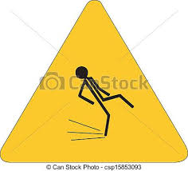
Is there an advantage?
Gastric secretion volume or pH not substantially different
Reduces thirst, hunger and fatigue
Reduces insulin resistance
Preserves nitrogen balance and lean body mass after surgery
What about diabetics?

Slide 28
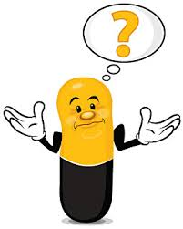
Premedication
Long acting anti anxiety
premedication is avoided.
Impairs patients mobility and ability to
take orally.
Do not withhold if the person is routinely on treatment.
Consider reduction of dose if bilirubin > 5 mg/dL

Slide 29
….anaesthesia
Induction: Propofol /thiopentone/etomidate
Intubation: Beware of mass obstructing the duodenum.
Relaxants: atracurium/cis atracurium
Narcotics: Fentanyl
Inhalational agents: Desflurane MAC awake reduced, Iso requirement reduced..prone for hypotension and bradycardia during induction.
Serotoninergic pathway.

Slide 30
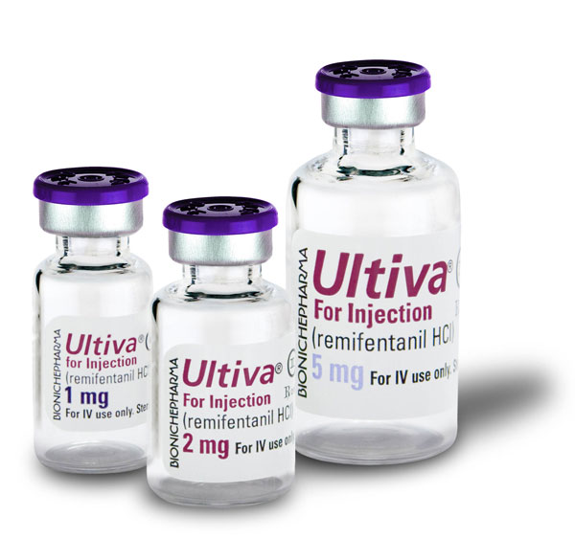
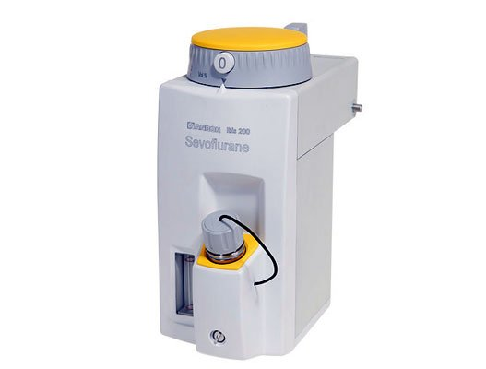
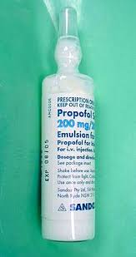
Intraoperative

Slide 31
Reduction of pain & stress response modulation
Analgesic infusions
Epidural/neuraxial block in open surgery.
TAP blocks and IV Lidocaine in lap surgery.
Multimodal analgesia.

Slide 32
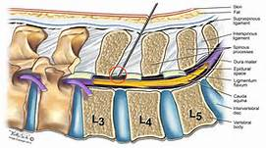
Epidural anaesthesia

Slide 33
CVP during hepatectomy

Slide 34
Low CVP should not lower arterial pressure

Slide 35
Choosing the right fluid!
Time | 1.40 pm | 5.15 pm | 7.15 pm | 8.15 pm | 6.00 am
pH | 7.37 | 7.29 | 7.25 | 7.18 | 7.15
pCO₂ | 34 | 35 | 35 | 28 | 31
pO₂ | 157 | 155 | 105 | 179 | 214
HCO₃ | 20 | 17 | 16 | 10 | 11
Lact | 2.1 | 3.9 | 4.4 | 11.6 | 16.6
K+ | 4.3 | 5.2 | 4.3 |  | 3.3
Hb | 12.6 | 9.7 | 7.9 | 9.4 | 11.4

Slide 36
Do we need to administer N-acetyl Cysteine
Supplement to scavenge the free radicles formed in the liver
Hepatectomy / portal vein clamping
Ischaemic Injury to the liver
100mg/kg = mg/16 = mgm/hr

Slide 37
When not to extubate
Prolonged surgery, blood loss or hypothermia
Ongoing bleed
Significant Acidosis
Compromised Vascular supply or lesser volume of liver

Slide 38
..summing up
Obstructive jaundice can be a challenge to the anesthesiologist
Understanding the pathophysiology and cause can improve preparation and management.
Impact of bile salts and acids on the vascular system is relevant.
Gram negative septicemia is a dreaded outcome in obstructed systems.
Multidisciplinary teams and specialty hepatobiliary units can improve outcomes.

Slide 39


